Slide 1
FRAUD DETECTION & ANOMALY ANALYSIS
Machine-learning based identification of suspicious transaction patterns
Presented By:
1. Vishwa Desai
2. Gujarat University (Prin. M.C. Shah Commerce College)
3. Commerce / Accounting & Finance
4. AICTE ID: STU6a69dd44436a11785322820

Slide 2
OUTLINE
⚑
Project Focus
■ Problem Statement
■ Proposed System / Solution
■ System Development Approach (Technology Used)
■ Algorithm & Deployment
■ Result
■ Conclusion
■ Future Scope
■ References
Detect unusual transaction behavior and surface records that merit review.
Repository
Desai-Vishwa/fraud-detection-anomaly

Slide 3
PROBLEM STATEMENT
Fraudulent transactions can resemble legitimate activity, making it difficult to identify suspicious behavior using manual review alone.
1
Volume & Scale
2
Rare & Irregular Events
3
False Alerts
Large transaction streams create too many records for exhaustive manual inspection.
Fraud is typically characterized by unusual patterns rather than a simple, repeated rule.
Over-flagging legitimate activity can waste analyst time and reduce trust in a detection system.
Goal: identify transactions that deviate from expected behavior and prioritize them for investigation.

Slide 4
PROPOSED SOLUTION
Build a repeatable anomaly-detection workflow that turns raw transaction data into actionable fraud flags.
D
1. Data
P
2. Prepare
A
3. Detect
R
4. Review
Load transaction records and preserve the fields needed for behavioral analysis.
Clean, validate and transform data so the model can identify meaningful deviations.
Apply anomaly detection to distinguish normal behavior from unusual observations.
Surface high-priority records for investigation and follow-up.
Expected output: an analyst-friendly set of anomaly flags / risk indicators that supports faster investigation.

Slide 5
SYSTEM APPROACH
Transaction Data
Data Cleaning
Feature Preparation
Anomaly Detection
Flagged Records
Investigation
R
Development Requirements
A
Analytical Steps
O
Operational Output
Python environment
Structured transaction dataset
Jupyter / script-based analysis
Version-controlled project files
Data inspection
Cleaning & transformation
Pattern / outlier analysis
Model scoring & review
Anomaly score / flag
Suspicious-record shortlist
Investigation support
Repeatable workflow

Slide 6
ALGORITHM & DEPLOYMENT
A
Algorithm Logic
D
Deployment Concept
1. Learn the pattern of normal observations.
2. Measure how strongly each record deviates from that pattern.
3. Convert the deviation into an anomaly flag / score.
4. Send the highest-priority cases to review.
The analytical pipeline can be exposed through a lightweight Python interface or dashboard for repeatable scoring and review.
E
Model Evaluation
Recommended measures: Precision, Recall, F1-score, confusion matrix, and threshold analysis. Use the project run to populate the exact values.

Slide 7
RESULT
Project Outcome
✓
Detect
Surface records that deviate from the learned / expected pattern.
→
Prioritize
Convert anomaly output into a review queue or risk indicator.
Normal transaction pattern
Act
!
Use human investigation to confirm or reject suspected fraud.

Slide 8
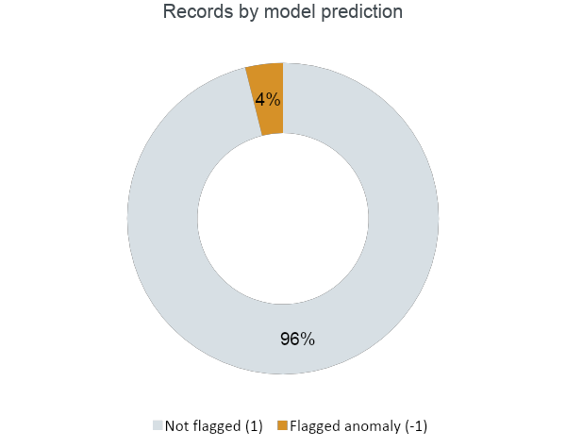
RESULT
Isolation Forest trained without labels flagged 1,471 records as anomalies.
37,721
Transactions monitored
1,471
Flagged for investigation
3.90%
Share of records flagged

Slide 9
RESULT
First five flagged records from the notebook, ready for analyst review.
Row | Time | V1 | V2 | V4 | Amount | Class | Flag
51 | 36 | -1.005 | -0.986 | 3.710 | 1,402.95 | 0 | -1
82 | 52 | -3.005 | 2.600 | -2.418 | 1.46 | 0 | -1
83 | 53 | -1.199 | -1.474 | -4.516 | 89.17 | 0 | -1
85 | 55 | -4.575 | -4.429 | 0.904 | 200.01 | 0 | -1
132 | 83 | -1.865 | 0.911 | -1.748 | 7.69 | 0 | -1
Detect
1
Surface records that deviate from the learned pattern.
Prioritize
2
Turn anomaly output into a review queue or risk indicator.
Act
Class = dataset label (0 normal, 1 fraud), kept aside during training. Flag -1 = anomaly.
3
Human investigation confirms or rejects suspected fraud.

Slide 10
CONCLUSION
The project demonstrates an end-to-end way to move from transaction data to anomaly-focused fraud investigation.
■ Reduces dependence on purely manual transaction screening.
■ Creates a repeatable analytical workflow for unusual-behavior detection.
■ Supports analyst review by highlighting records that deserve attention.
■ Provides a foundation for stronger evaluation, monitoring and deployment.
Key takeaway: anomaly detection is a practical first layer for fraud screening, with human validation remaining important.

Slide 11
FUTURE SCOPE
F
1. Better Features
M
2. Model Comparison
X
3. Explainability
Add temporal, behavioural and contextual features to improve anomaly separation.
Compare multiple anomaly-detection methods and select thresholds against business costs.
Show why a record was flagged so investigators can validate the signal faster.
R
4. Real-time Scoring
D
5. Monitoring
H
6. Human-in-the-loop
Move from batch analysis to streaming or near-real-time transaction screening.
Track drift, alert quality and threshold performance after deployment.
Feed analyst decisions back into the workflow for continuous improvement.

Slide 12
REFERENCES
■ 1. Project Repository — GitHub: Desai-Vishwa/fraud-detection-anomaly
■ 2. Python Documentation — Python language and standard tooling reference
■ 3. Scikit-learn User Guide — Machine Learning / Anomaly Detection reference
■ 4. SkillsBuild Partner Update — Capstone Project template provided for submission
Repository URL: https://github.com/Desai-Vishwa/fraud-detection-anomaly

Slide 13
DEPLOYMENT LINK / GITHUB LINK
GitHub Repository
https://github.com/Desai-Vishwa/fraud-detection-anomaly

Slide 14
THANK YOU
Fraud Detection & Anomaly Analysis
Vishwa Desai | Capstone Project

